Slide 1





NATURAL CAPITAL ACCOUNTING (NCA) FOR RWANDA
FOUNDATIONS AND POLICY RELEVANCE
10-Day Training & Capacity Development Programme
National Institute of Statistics Rwanda (NISR) & Partner MDAs
PRESENTED BY:
DATE:
Dr. Shakeel Hayat
19 January 2026

Slide 2

PURPOSE OF THE TRAINING
Why This Training Programme?
Rwanda’s development is strongly dependent on natural assets
Traditional economic statistics do not capture natural assets depletion
NCA provides a structured way to integrate nature into decision-making
This programme focuses on institutionalising NCA, not one-off studies

Slide 3




LEARNING OBJECTIVES
By the End of Day-1, Participants Will:
Understand why NCA matters for Rwanda’s economy
Recognise limitations of GDP and traditional indicators
Understand Rwanda’s policy motivations for NCA
Be clear on institutional roles and expectations

Slide 4

STRUCTURE OF THE 10-DAY PROGRAMME
Training Design
Conceptual grounding
Technical application
Practical, Rwanda-specific exercises
Institutional and governance focus
Outcome-oriented, not academic

Slide 5



WHAT WE AIM TO BUILD
End-of-Programme Outcomes
CORE NCA CAPACITY WITHIN NISR AND MDAs
PRIORITY NATURAL CAPITAL ACCOUNTS FOR RWANDA
CLEAR INSTITUTIONAL COORDINATION FRAMEWORK
INPUTS TO A NATIONAL NCA ROADMAP

Slide 6
WHY GDP IS NOT ENOUGH
Limitations of GDP
Measures economic flows, not asset stocks
Ignores depletion of land, water, forests
Treats environmental degradation as economic gain
Cannot assess long-term sustainability

Slide 7
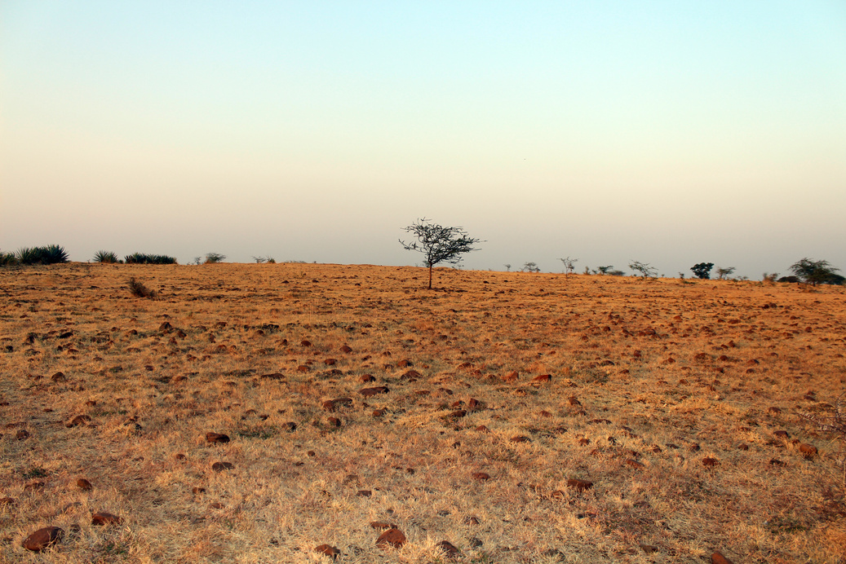


THE HIDDEN COSTS IN GDP
What GDP Does Not Show
SOIL EROSION & LAND DEGRADATION
OVER-EXTRACTION OF WATER RESOURCES
FOREST DEGRADATION & BIODIVERSITY LOSS
LONG-TERM CLIMATE & RESILIENCE RISKS

Slide 8
RWANDA’S ECONOMY IS NATURE-BASED
WATER RESOURCES
LAND AND SOILS
Key Natural Assets Supporting the Economy
FORESTS AND ECOSYSTEMS
MINERAL RESOURCES

Slide 9


NATURAL CAPITAL AND KEY SECTORS
Sectoral Dependence on Nature
Agriculture and food security
Hydropower and water supply
Tourism and biodiversity
Urban development and land use

Slide 10
CLIMATE RISKS AND NATURAL CAPITAL
Nature as Climate Infrastructure
Flood regulation
Water storage and recharge
Soil protection
Climate adaptation and resilience
NCA helps quantify these benefits

Slide 11


WHAT IS NATURAL CAPITAL ACCOUNTING?
Natural Capital Accounting (NCA)
A system to measure natural assets and flows
Integrates environment into economic accounts
Uses internationally agreed statistical standards
Supports informed policy and planning

Slide 12
EXPECTED OUTCOMES
Linking Environment and Economy
Environmental data → Economic decision-making
Physical indicators → Policy-relevant evidence
Long-term assets → Sustainable development

Slide 13
RWANDA’S POLICY CONTEXT
Key National Frameworks
Vision 2050
National Strategy for Transformation (NST-1)
Green Growth & Climate Resilience Strategy
Nationally Determined Contributions (NDCs)
Sustainable Development Goals (SDGs)

Slide 14

VISION 2050 AND
NATURAL CAPITAL
Vision 2050 Priorities
High-income, resilient economy
Sustainable land and resource use
Long-term asset management
NCA provides evidence to support these goals

Slide 15
NST-1 AND EVIDENCE-BASED PLANNING
NST-1 Needs Better Information On:
Trade-offs between growth and sustainability
Resource productivity
Long-term development risks
NCA strengthens planning credibility

Slide 16
CLIMATE COMMITMENTS AND NCA
Supporting Rwanda’s NDCs
Tracking land-use and ecosystem changes
Supporting adaptation planning
Linking mitigation with ecosystem health

Slide 17
NCA AND THE SDGS
Key SDGs Supported by NCA
SDG 6 – Water
SDG 13 – Climate Action
SDG 15 – Life on Land
NCA provides measurable indicators

Slide 18
FROM POLICY STATEMENTS TO NUMBERS
Why Policymakers Need NCA
Clear, quantified evidence
Transparent trade-offs
Stronger investment decisions
Long-term fiscal realism

Slide 19
GLOBAL EVOLUTION OF NCA
From Concept to Standard
Early environmental statistics
Satellite accounts
Adoption of System of Environmental-Economic Accounting (SEEA) as UN standard

Slide 20
WHAT IS SEEA?
System of Environmental-Economic Accounting
International statistical standard
Developed under UN leadership
Comparable across countries
Policy-neutral framework

Slide 21
WHAT SEEA IS NOT CONSIDERING
Important Clarifications
Not environmental advocacy
Not compulsory monetization
Not a project-based tool
It is an accounting system

Slide 22
RWANDA’S EXPERIENCE WITH NCA
Progress to Date
Pilot assessments
Sector-specific studies
Growing policy interest

Slide 23
KEY GAPS IDENTIFIED
Lessons Learned
Fragmented data systems
Limited coordination
Lack of institutional ownership
This programme addresses these gaps

Slide 24
WHY INSTITUTIONALIZATION MATTER
NCA Is a System, Not a Study
Requires multiple institutions
Needs clear roles and coordination
Depends on data sharing and trust

Slide 25
ROLE OF NISR
NISR as Lead Institution
Custodian of national accounts
Technical leadership on SEEA
Quality assurance and integration
Coordination across MDAs

Slide 26
ROLE OF MDAS
MDAs’ Responsibilities
Producing sectoral data
Technical validation
Using NCA results in policy

Slide 27
DATA PRODUCERs VS DATA USERs
Different Roles, Same Objective
• Not all institutions compile accounts
• All institutions use the outputs
• Clear division of responsibilities is essential

Slide 28
EXPECTATIONS FROM PARTICIPANTs
During the 10 Days
Active engagement
Institutional perspective
Practical contributions
Openness to coordination

Slide 29
WHAT WILL BE BUILT TOGETHER
Over the Next 10 Days
Priority natural capital accounts
Data gap matrices
Institutional coordination framework
Inputs to national NCA roadmap

Slide 30
DAY-1 KEY TAKEAWAYS
Key Messages
Rwanda’s economy depends on natural capital
GDP alone is insufficient
NCA makes natural assets visible
Institutions are central to success

Slide 31
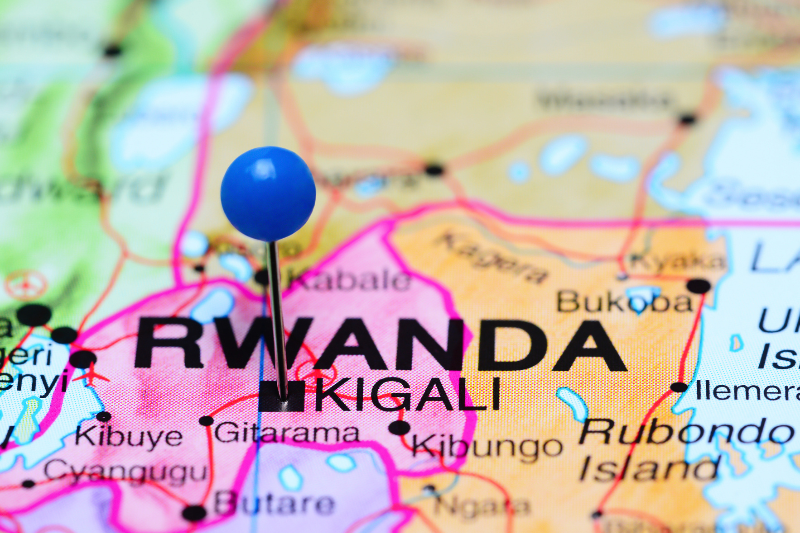
THANK
YOU
ura

